Slide 1
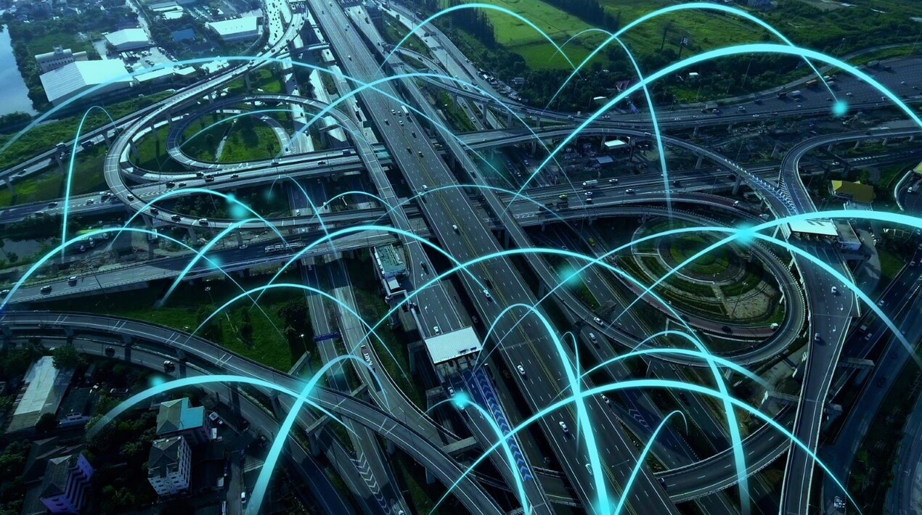
IDEA TITLE
A smart AI based solution for traffic management on routes with heavy traffic from different directions, with real-time monitoring and adaptation of traffic light timings

Slide 2
Abstract
Challenge: Urban traffic congestion at intersections with multiple converging routes often results from static traffic light timings, leading to inefficiencies such as increased wait times, fuel consumption, and emissions.
Objective: Developng an AI-driven traffic management system that dynamically adjusts traffic light timings in real-time to better handle heavy traffic from various directions.
Real-Time Data Integration: This system will utilize sensors, cameras, and IoT devices to continuously collect and analyze real-time traffic data, including vehicle flow, speed, and congestion levels.

Slide 3
Abstract
Adaptive Algorithms: It employ’s advanced machine learning algorithms to process the real-time data, predict traffic patterns, and optimize traffic signal timings to alleviate congestion and improve traffic flow.
Efficiency Improvements: By adjusting signal timings dynamically, the system aims to reduce delays, enhance road safety, and lower fuel consumption and emissions, thereby contributing to a more efficient and environmentally friendly traffic management solution.

Slide 4
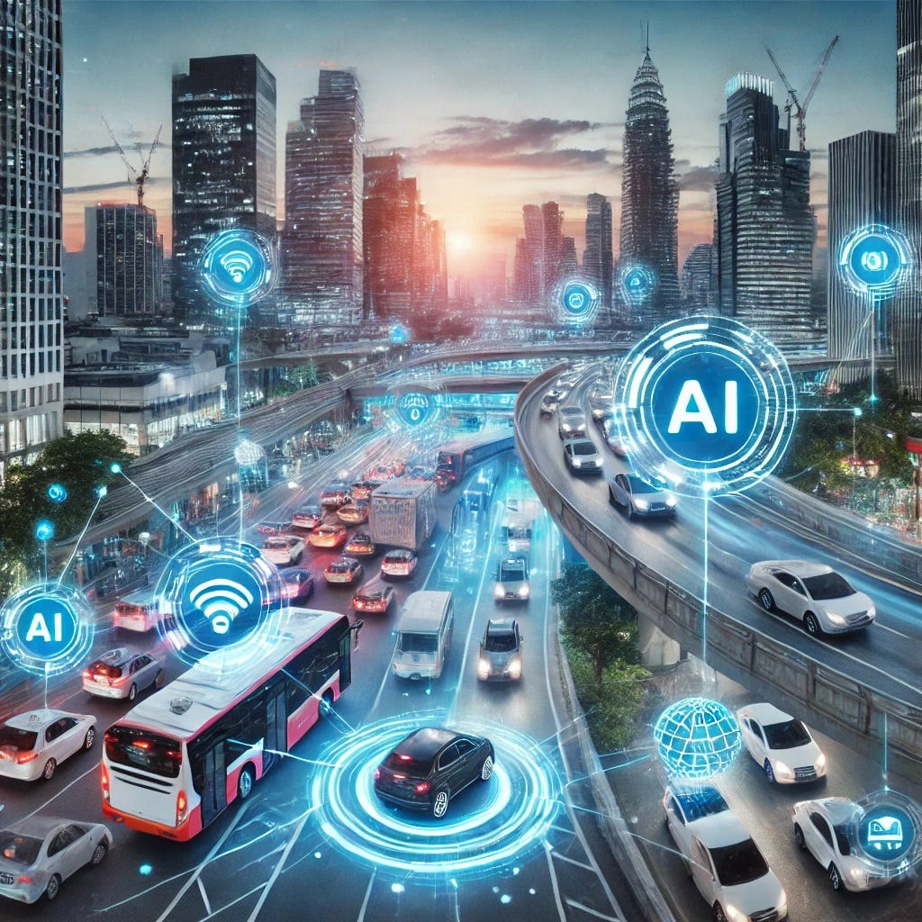
Objectives:
The main objectives are as follows:
1. Real-Time Traffic Monitoring
2. Incident Detection and Response
3.Dynamic Traffic Light Adjustment
4. Emergency Vehicle Detection and Prioritization
5. Vehicle number plate identification

Slide 5
Collecting Data: Gathering information about traffic from sensors, cameras, and GPS. This includes things like how many cars are on the road, how fast they’re going, and where traffic jams are happening.
Building Models: By creating AI models that can predict traffic conditions and suggest how to improve traffic flow. This could involve predicting rush hours or finding the best traffic light timings.
programming languages:
python: It is suitable for developing the machine learning models,data processing pipelines,and integrating various APIs.
TECHNICAL APPROACH

Slide 6
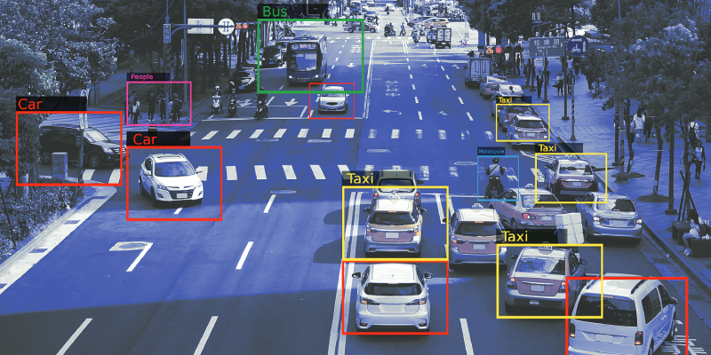
Frameworks and Libraries:
OpenCV:
An Open-source computer vision library used for real-time image and video processing,crucial for analyzing traffic camera feeds.
YOLO(You only look once):
A state-of-the-art,real-time object detection system,useful for vehicle detection ,counting,and tracking from video feeds.
Hardware Components:
High-resolutions cameras
IoT sensors
Traffic signal controllers
Lidars

Slide 7
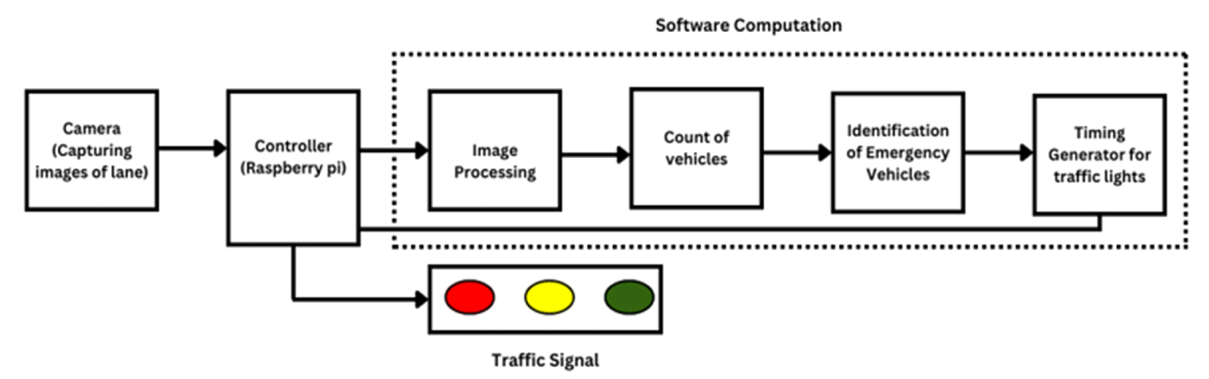
Block diagram:

Slide 8
IMPACT AND BENEFITS
Smart Traffic Lights: AI adjusts traffic light timings based on real-time traffic, helping to keep things moving smoothly.
Lower Emissions: By reducing traffic idling, AI helps cut down on pollution from vehicles.
Less Manual Work: Reduces the need for manual traffic control, saving on labor costs and maintenance.There is no need of traffic police officer standing alone in the junction roads.
Adaptive Control: AI can continuously adjust traffic signals and manage traffic flow in real-time based on current conditions.
Detects emergency vehicle: Immediately detects the emergency vehicles like ambulance and fire control vehicles and immediately allows the lane in which the vehicle is situated.
Preventive Measures: By managing traffic flow and emergency vehicle movements more effectively, AI can help reduce the likelihood of accidents, particularly those that occur when drivers are unaware of approaching emergency vehicles.

Slide 9
RESEARCH AND REFERENCES
World meter- Real time world statistics, 2020 (website) worldometers.info
(Accessed May 1, 2022).
G.S. Khekare, A.V. Sakhare, "A smart city framework for intelligent traffic system
using VANET," automation, computing, communication, control and compressed
sensing (iMac4s), 2013, Int. Multi Conf. (2013) 302. vol., no.305, 22-23 March.
M.F. Hashmi, AG. Keskar, Analysis and monitoring of a high-density traffic flow at
T-intersection using statistical computer vision-based approach, in: Proceedings of
the Intelligent Systems Design and Applications (ISDA), 2012 12th International
Conference on, IEEE, 2012.
R. Kaviani, P. Ahmadi, I. Gholampour, A new method for traffic density estimation
based on a topic model, in: Proceedings of the Signal Processing and Intelligent
Systems Conference (SPIS), 2015, IEEE, 2015.

Slide 10
THANK YOU

